Slide 1

Hotel Booking Analysis
By Gilbert Garza & Eva Beyebach

Slide 2
Summary
This data comes from an open hotel booking demand dataset from Antonio, Almeida and Nunes' article: Hotel Booking Demand Datasets
The article describes two datasets regarding hotel demand. One of the hotels (H1) is a resort hotel and the other is a city hotel (H2). Both datasets share the same structure, with 31 variables describing the 40,060 observations of H1 and 79,330 observations of H2. Each observation represents a hotel booking.
Intro
Data Preparation
Exploratory Data Analysis
Modeling
Conclusion

Slide 3
Goal
By studying the data:
We are trying to find out why both hotels are having cancellations and also provide a better customer overview to achieve greater customer satisfaction
We want to find which variables affect cancellation rate the most, ultimately, give us a better understanding of cancellation occurance and how to prevent them in the future. Some questions we look to answer include:
Which hotel has a higher count of cancellations?
Do certain countries have higher cancellation rates than others?
Which seasons or months tend to have the highest number of cancellations?
How does the pricing differ per type?
Which other variables affect cancellation, and repeated guests?
Intro
Data Preparation
Exploratory Data Analysis
Modeling
Conclusion

Slide 4
To approach this problem, we will perform Data Preparation, EDA and Modelling to predict whether a booking is going to be cancelled or not . We will also perform some correlations and visualizations to see which variable best predict cancellations.
The end user will benefit from the analysis because he will be able to know which booking might end up in cancellations. He will also know customer segmentation and will be able improve its marketing to get more revenue from the hotels.
Intro
Data Preparation
Exploratory Data Analysis
Modeling
Conclusion

Slide 5
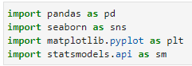
Required Packages
pandas: analyzing, cleaning, exploring, and manipulating data
seaborn: data visualization library built on top of Matplotlib
matplotlib.pyplot: make matplotlib work like MATLAB (used for figures)
statsmodels.api: provides various statistical models and functions to explore, analyze, and visualize data
Intro
Data Preparation
Exploratory Data Analysis
Modeling
Conclusion

Slide 6
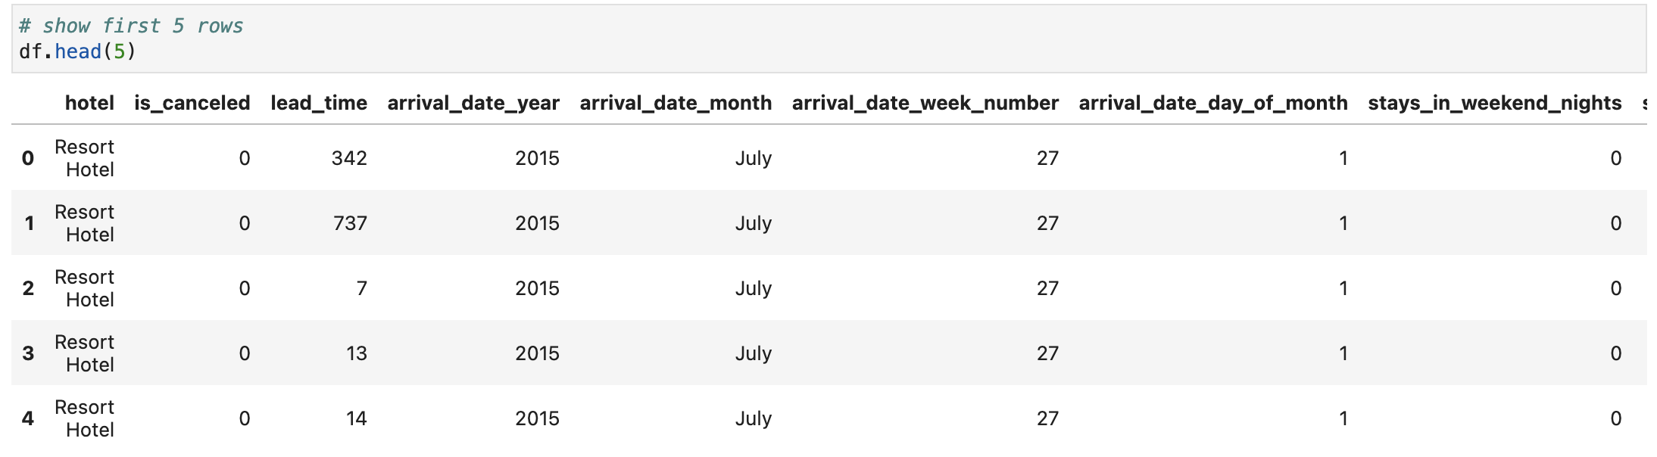
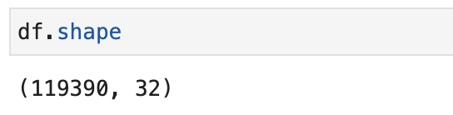
Data Description
We have 32 variables (columns) and 119,390 observations
Intro
Data Preparation
Exploratory Data Analysis
Modeling
Conclusion

Slide 7
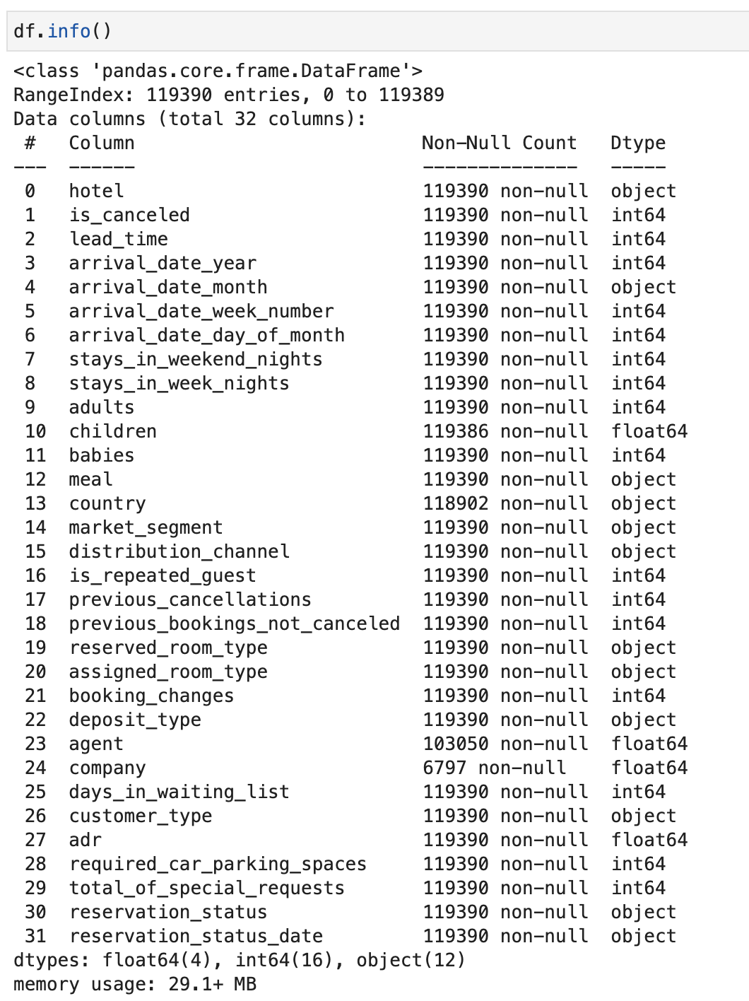
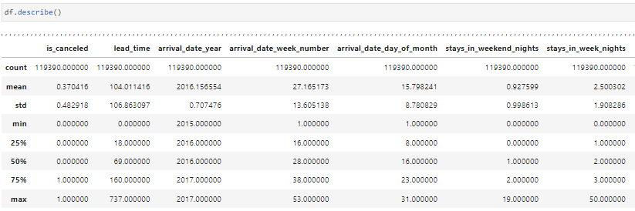
From looking at the columns info, we notice:
Reservation_status_date should have date type
Agent, children, and company should be int64 type
Statistical Description of the Hotel Data
Note: cropped for the sake of visual
From this, we can conclude the following:
The majority of columns appear to have a skewed distribution
There might be outliers (for example adr has a MAX of 5400, yet its mean is 100. We can further look for outliers in the analysis)
Quick glance of columns and their type
Intro
Data Preparation
Exploratory Data Analysis
Modeling
Conclusion

Slide 8
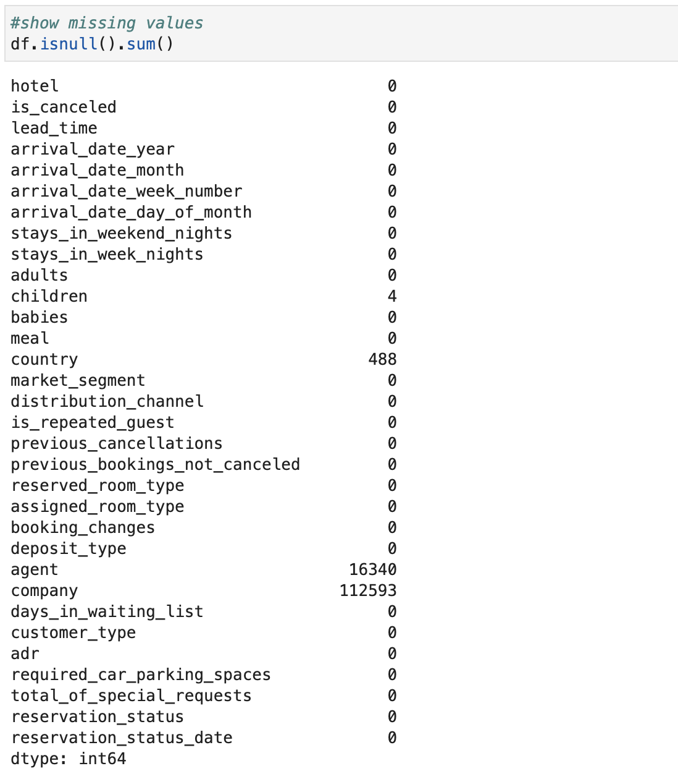
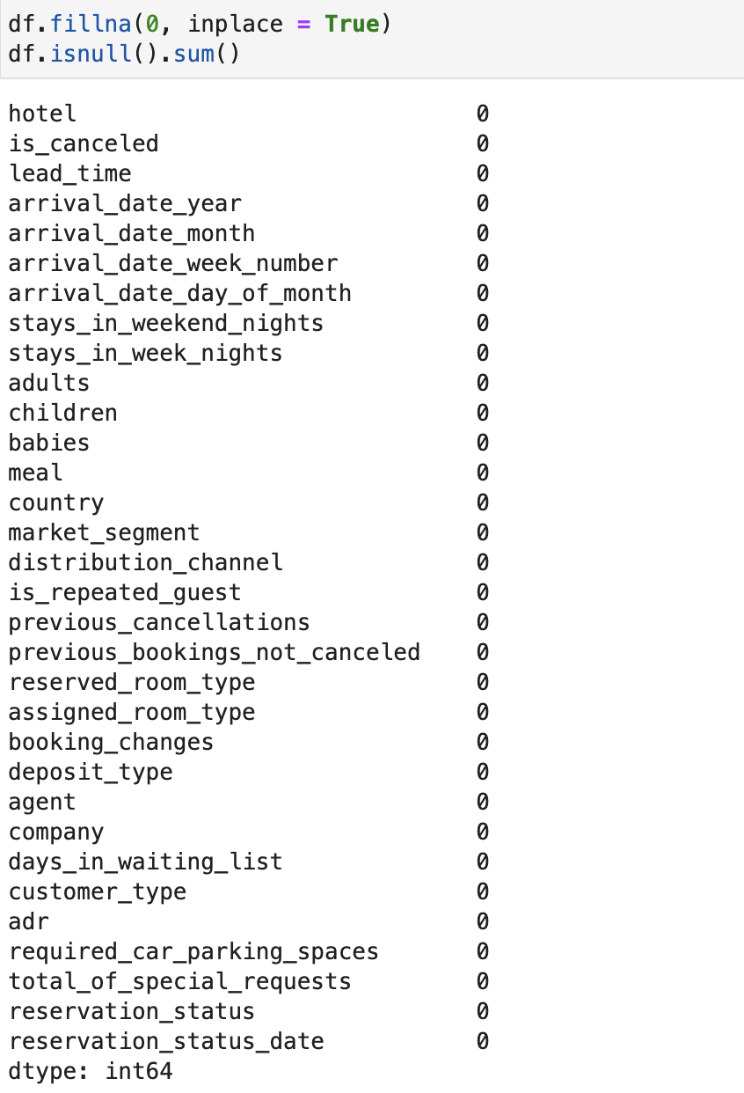
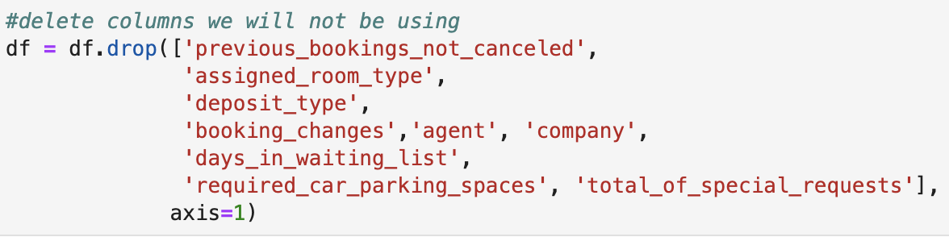
Cleaning
It is important to check if data has NULL values that can mess with the integrity of data.
Here we find:
Country has 488
Agent has 16,340
Company has 112,593
For ease,
we will delete variables that we find unnecessary to predict cancellations
We then fill those NULL values
Intro
Data Preparation
Exploratory Data Analysis
Modeling
Conclusion

Slide 9
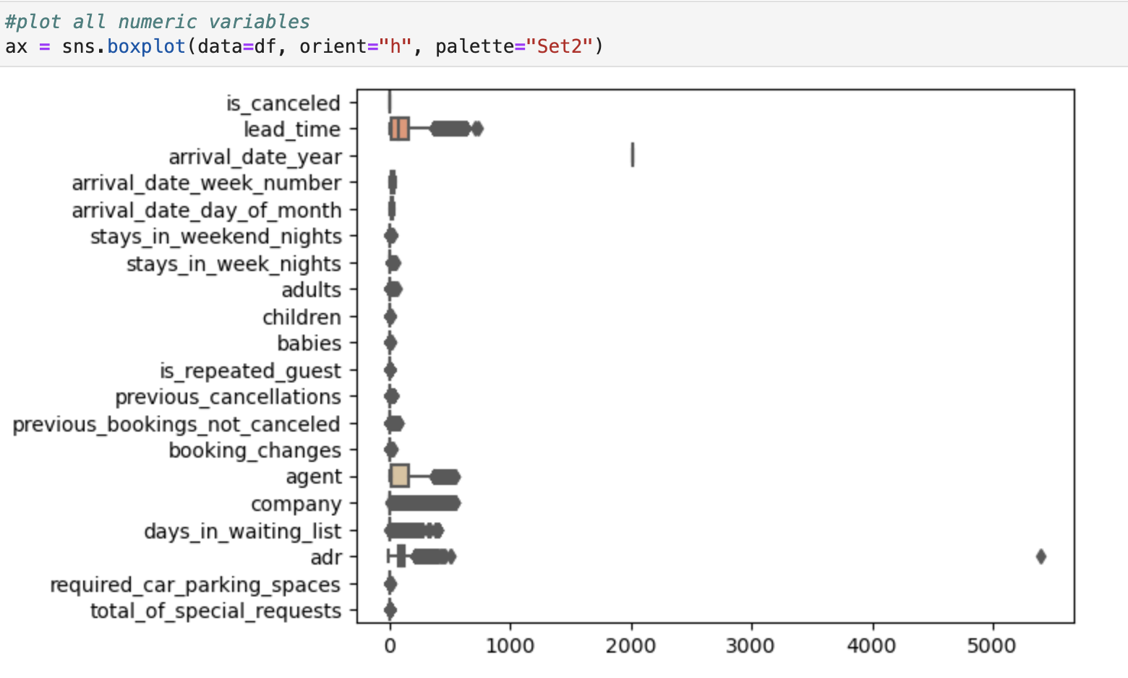
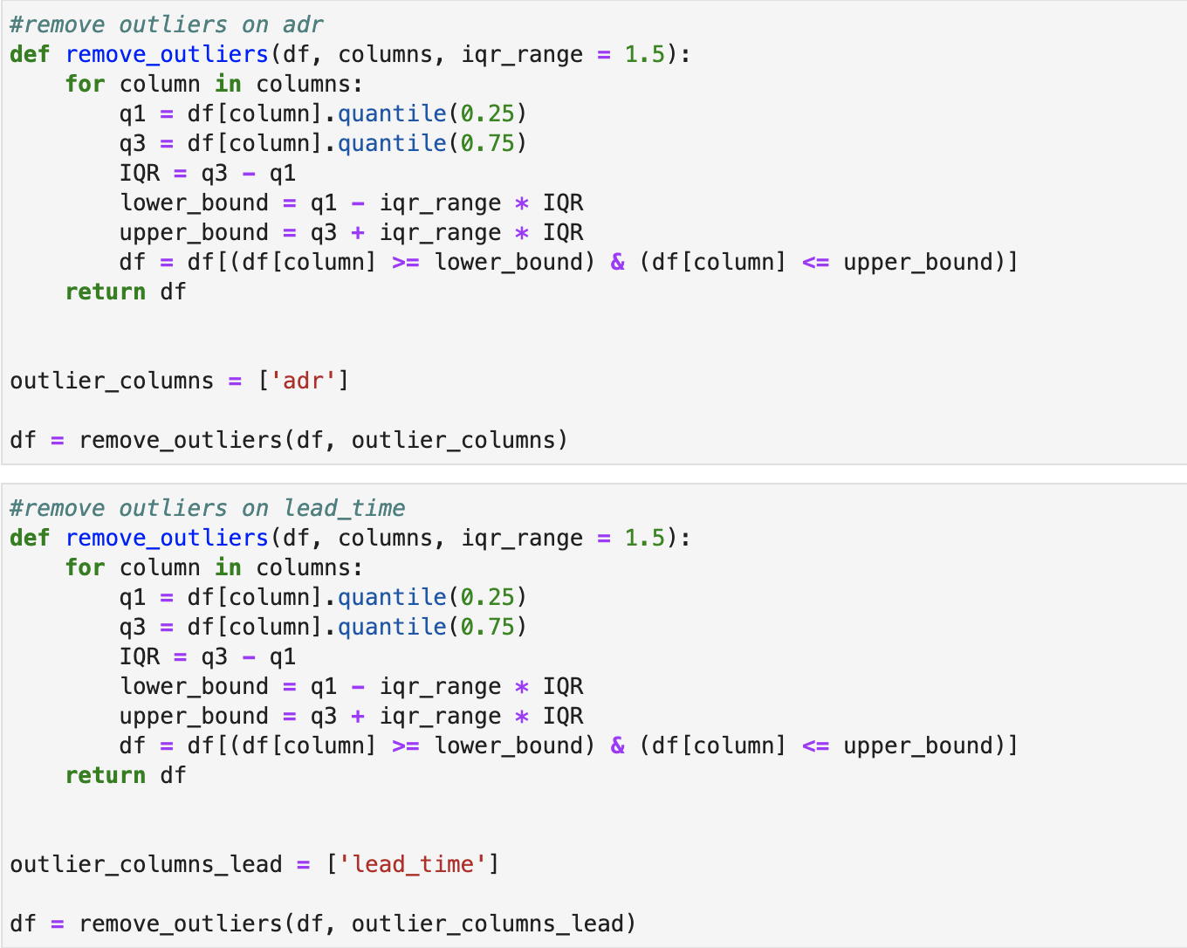
Outliers
Outliers can cause anomalies, affecting results
Reduce accuracy of model
Shift/pull the line in regression models
Increase variability
We can already see outliers present at adr and lead time. Now we fix:
Intro
Data Preparation
Exploratory Data Analysis
Modeling
Conclusion

Slide 10
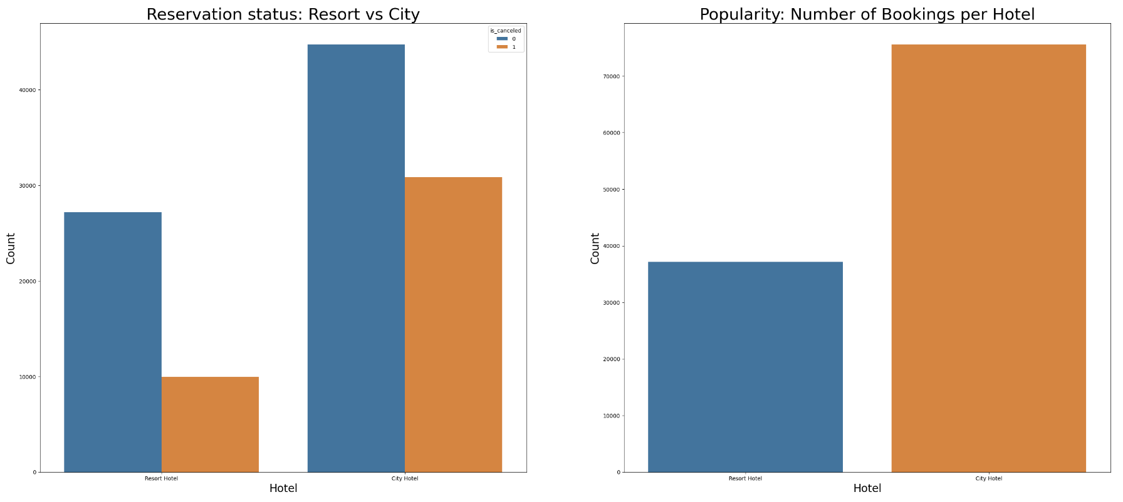
Let the plotting begin!
City vs Resort Hotel
We see that City Hotel has the highest number of bookings but in proportion is also has the highest number of cancellations.
Intro
Data Preparation
Exploratory Data Analysis
Modeling
Conclusion

Slide 11
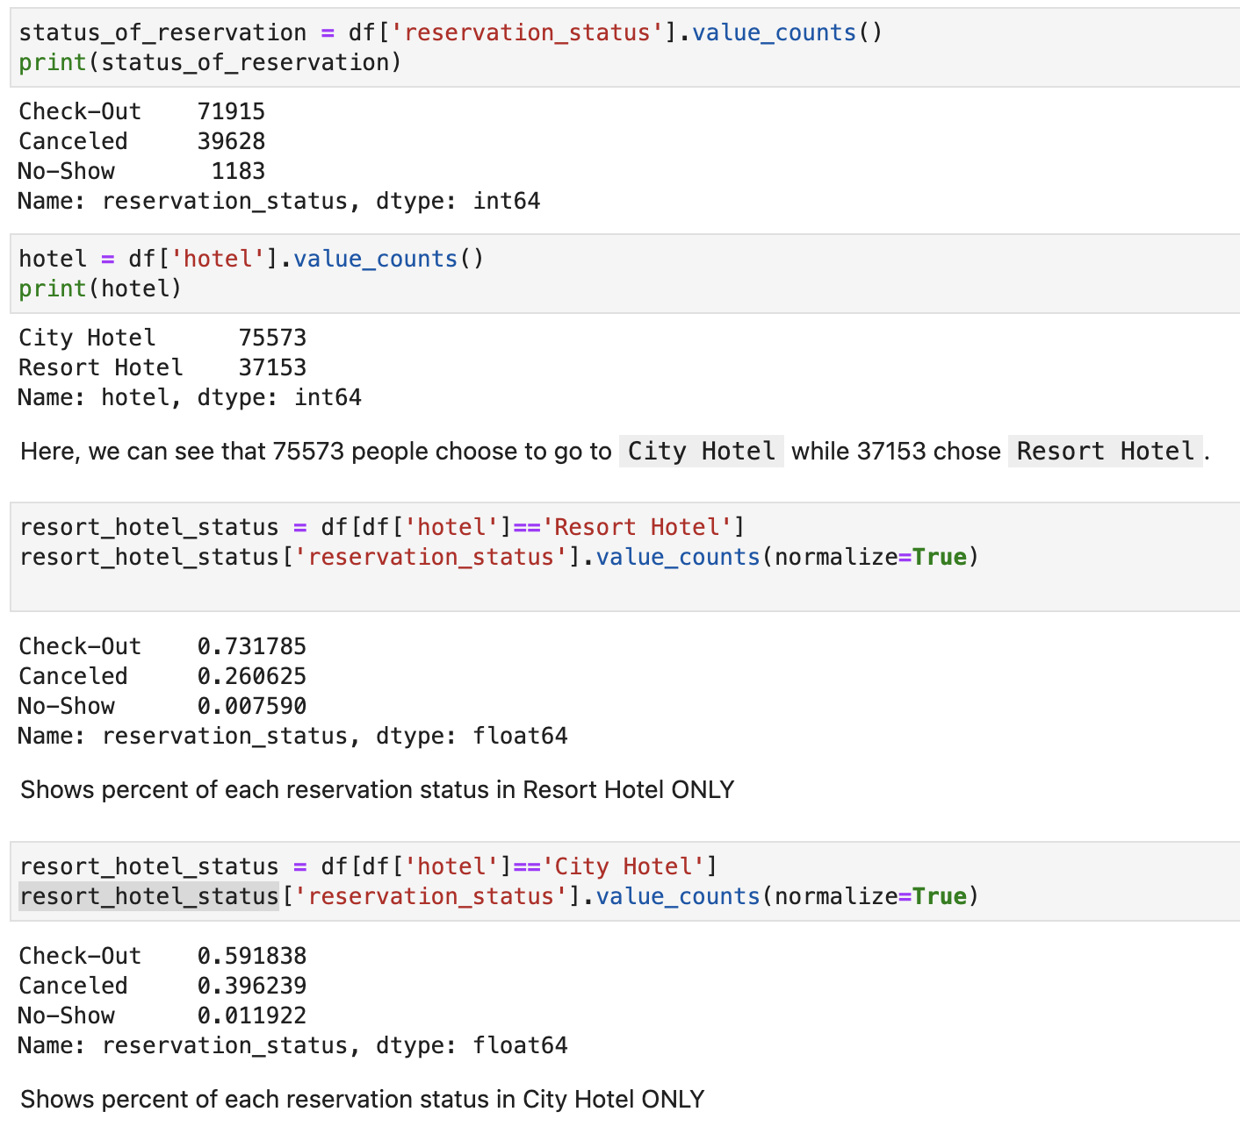
Cancellation ratio: city vs resort
Observation:
In Resort Hotel 26% cancelled, while in City Hotel 39.7% cancelled.
City Hotel has a higher Cancellation Ratio than Resort Hotel.
Intro
Data Preparation
Exploratory Data Analysis
Modeling
Conclusion

Slide 12
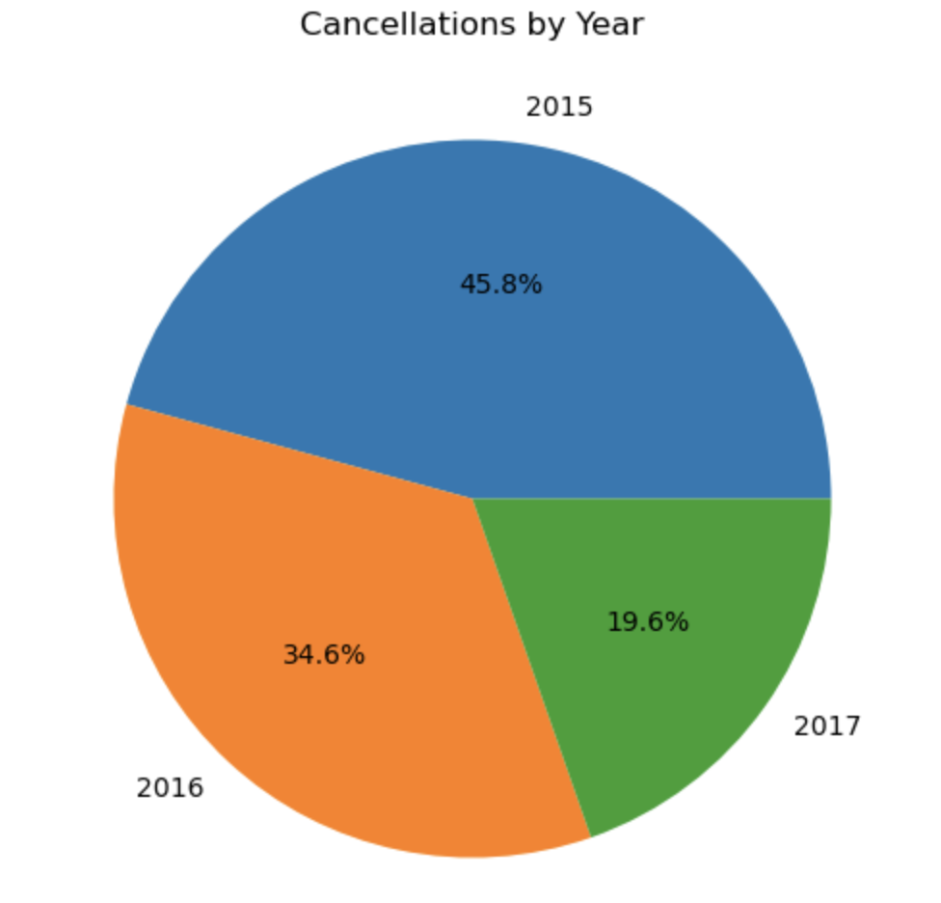
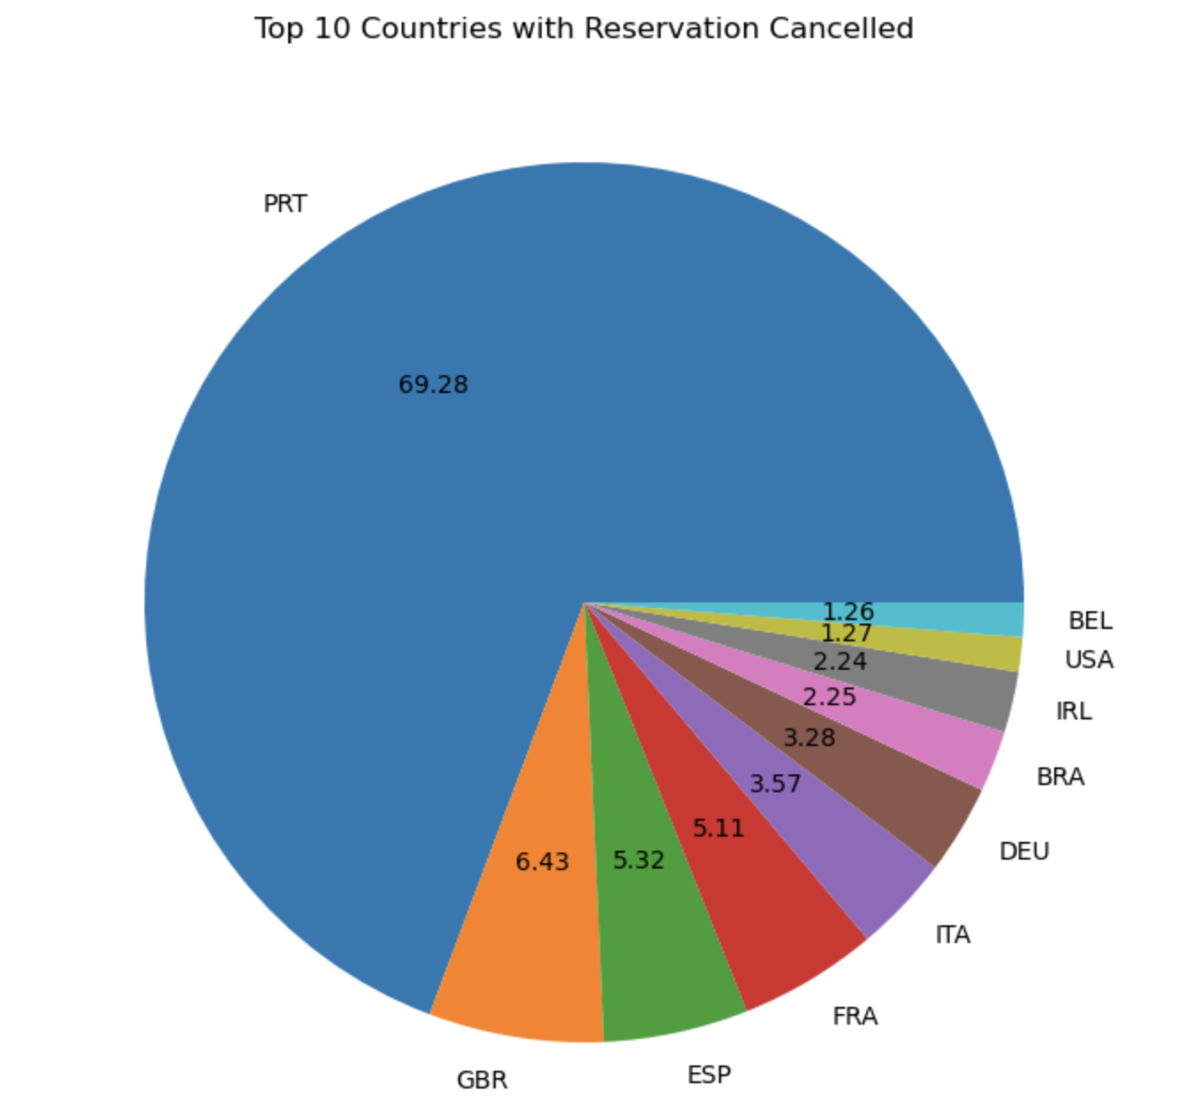
Cancellation Per year and country
2015 was the year with most cancellations
Portugal is the country with most cancellation, followed by GBR and ESP.
But what is the cancellation ratio?
Intro
Data Preparation
Exploratory Data Analysis
Modeling
Conclusion

Slide 13
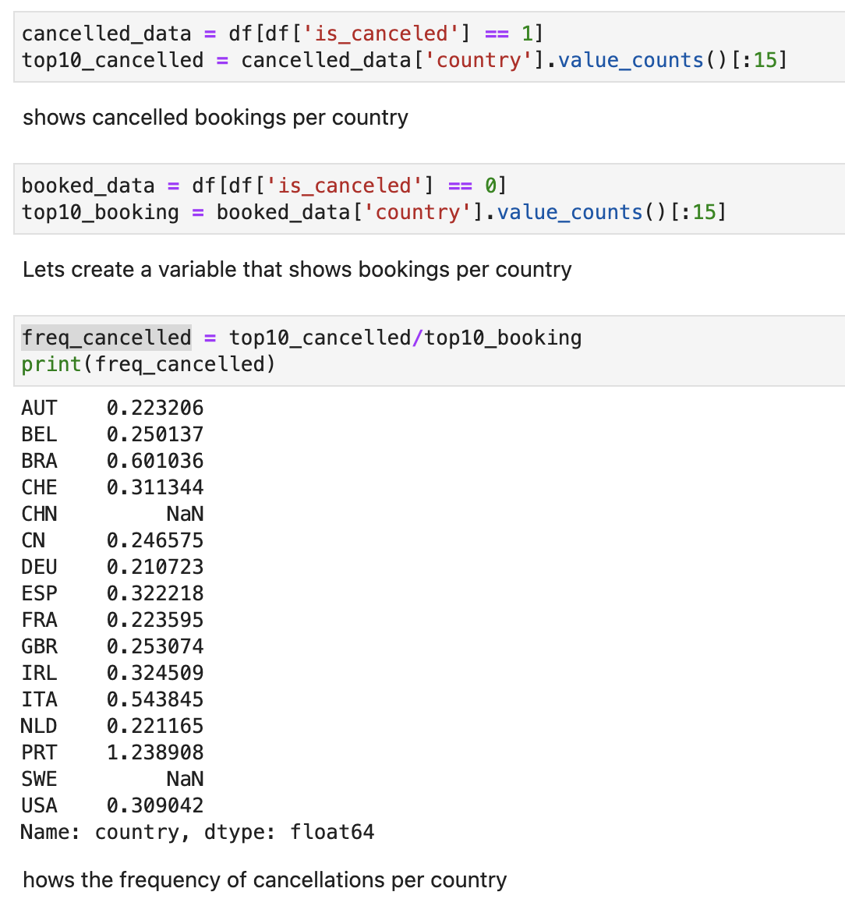
Cancellation ratio
We can see that Portugal has the highest number of cancellations (with a ratio of 1.3, meaning that they have more cancellations than bookings)
Then Brazil (0.601) and Italy (0.544)
Notice this differs from the Pie Chart. Pie chart uses value counts, while this is frequency
Intro
Data Preparation
Exploratory Data Analysis
Modeling
Conclusion

Slide 14
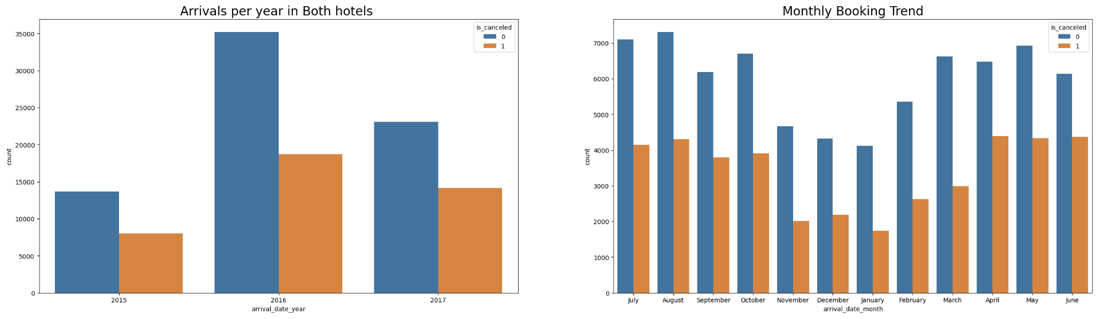
Histograms: reservations per year and month
2016 has smaller cancellation ratio than 2015 and 2017
August had the highest number of bookings but also the highest number of cancellations.
June had the highest number of cancellations in proportion to bookings.
Intro
Data Preparation
Exploratory Data Analysis
Modeling
Conclusion

Slide 15
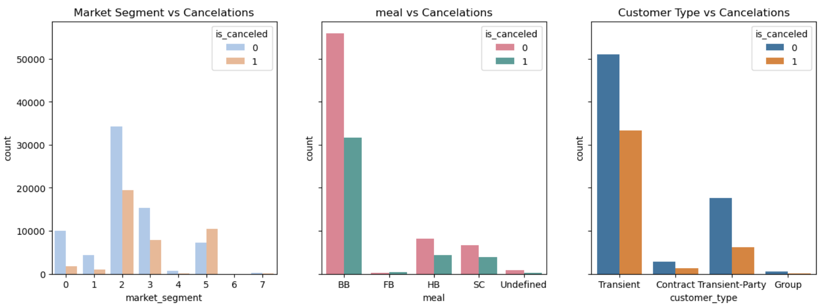
Histograms: market segment, meal, and customer type
Change market segment to categorical
Observations:
Groups have the highest cancellation ratio
FB has more cancellations than non-cancellations
Transient has the highest cancellation ratio out of customer type
Intro
Data Preparation
Exploratory Data Analysis
Modeling
Conclusion

Slide 16
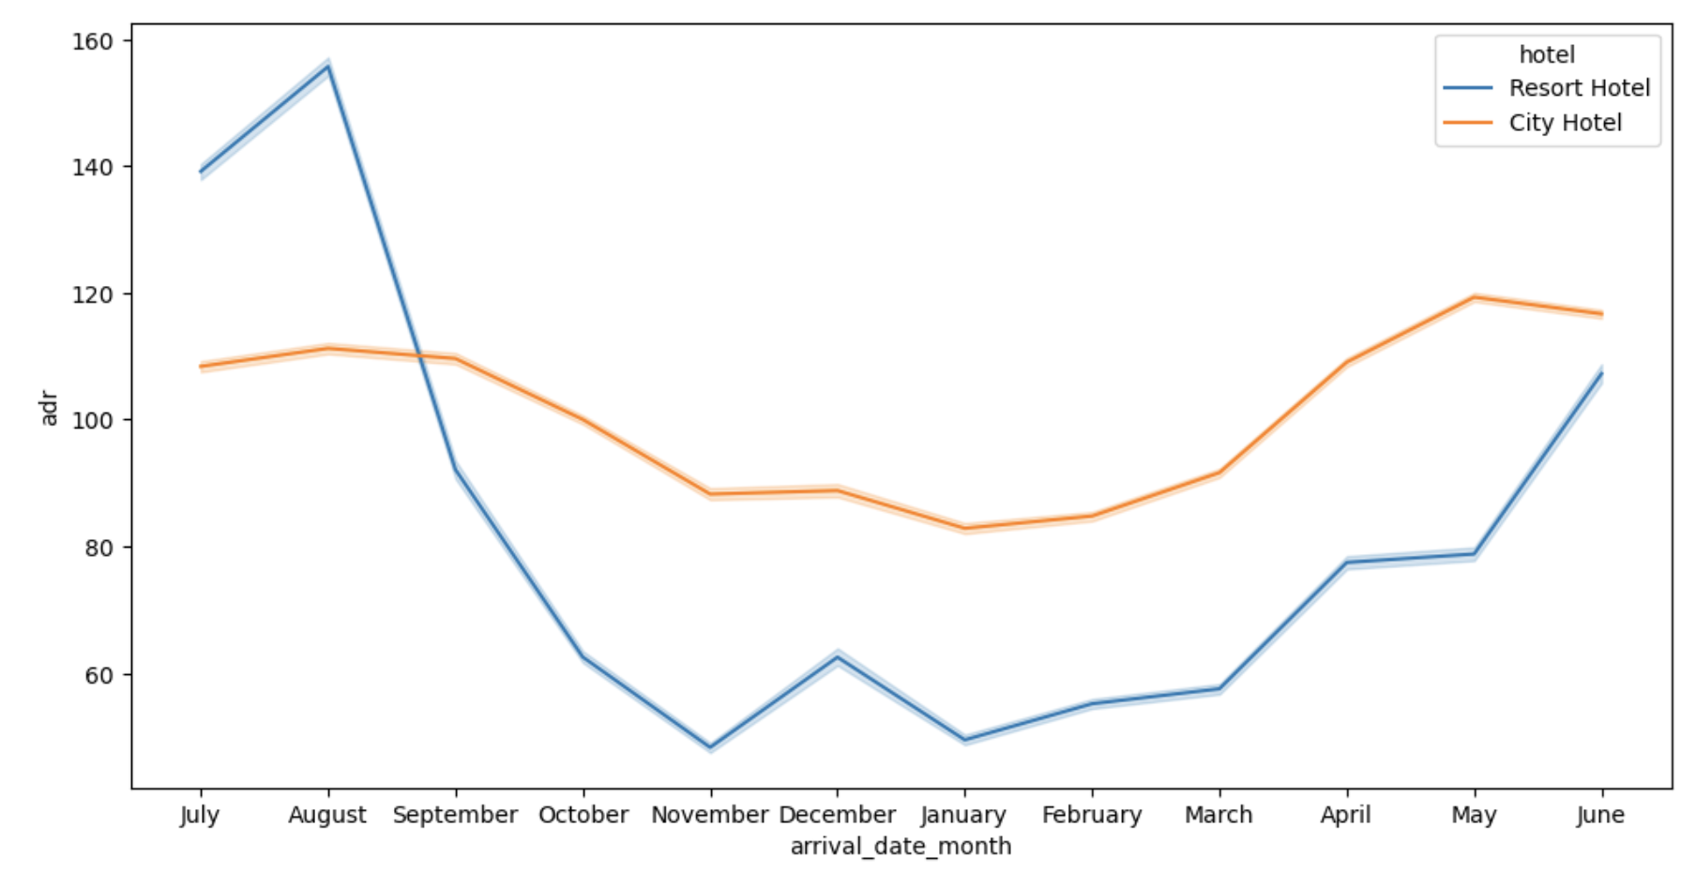
Visuals using line plots
Hotel vs resort: adr per month
ADR per Month and Hotel
July, August and September Resort Hotel has much higher prices and peaks
It drops and has lower prices than City Hotel from September until June
City Hotel has a much more constant price.
However, highest cancellation ratio was in June, when price is increasing
Intro
Data Preparation
Exploratory Data Analysis
Modeling
Conclusion

Slide 17
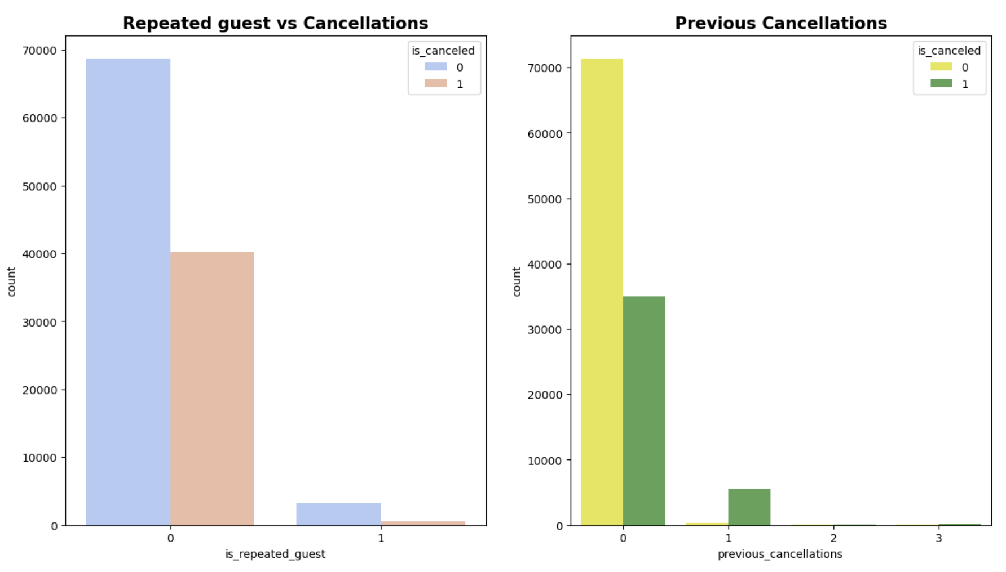
histograms
cancellation counts: repeated guests and previous cancellations
Low number of repeated guests
Repeated guest have a low cancellation ratio
If they had a cancellation already, it is more likely that they will cancel again
Intro
Data Preparation
Exploratory Data Analysis
Modeling
Conclusion

Slide 18
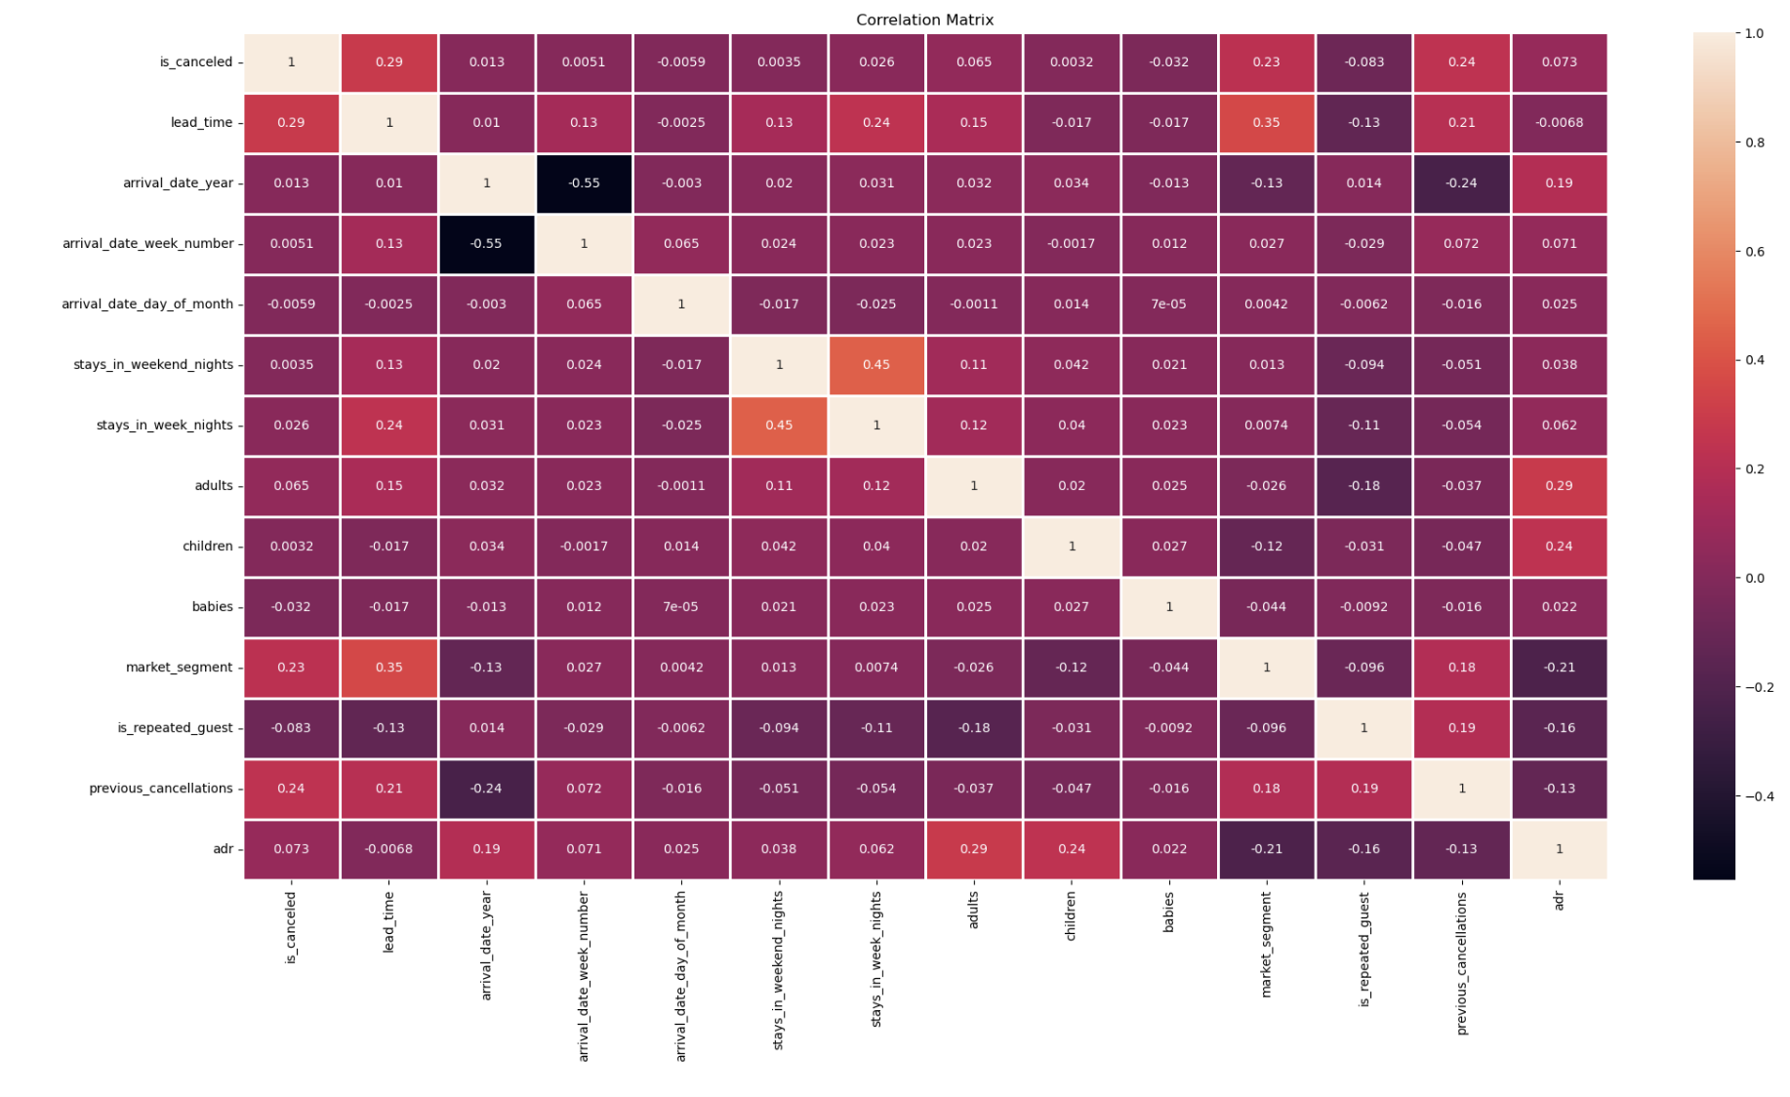
heat map: correlation between variables
Cancellation correlates the most with lead_time (0.29), followed by previous_cancellation and market_segment.
is_repeated_guest correlates the most with previous cancellations, followed by adults and adr.
arrival_date_year and arrval_date_week_number have also a high negative correlation (-0.55)
Intro
Data Preparation
Exploratory Data Analysis
Modeling
Conclusion

Slide 19
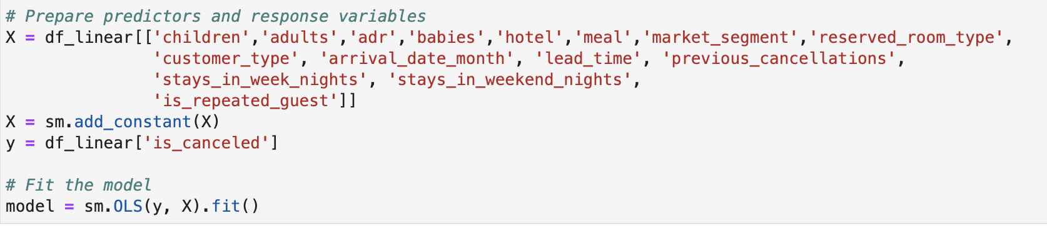
linear regression
a statistical method that models the relationship between a dependent variable and one or more independent variables by fitting a linear equation to the observed data
First.
We convert all variables into categorical
Make sure there is no missing values
Intro
Data Preparation
Exploratory Data Analysis
Modeling
Conclusion

Slide 20
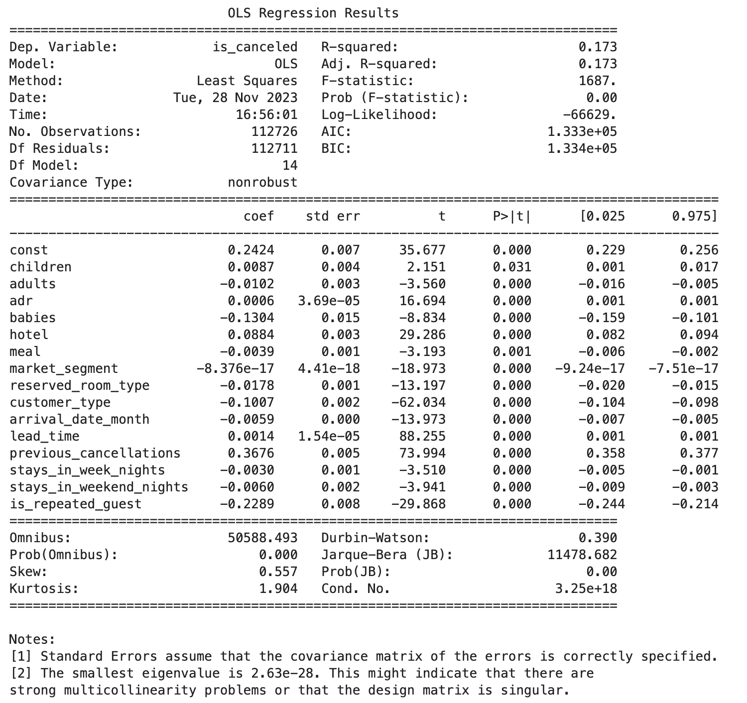
linear regression
Observation:
all the variables are significant
R^2 = 17.30
Variables with the highest coefficients are previous_cancellations, is_repeated_guest and babies
Lead time and market segment do not play an important role as they did in the correlation matrix.
Coefficients do not necessarily mean that they are the best predictors, since the units vary among them.
Intro
Data Preparation
Exploratory Data Analysis
Modeling
Conclusion

Slide 21
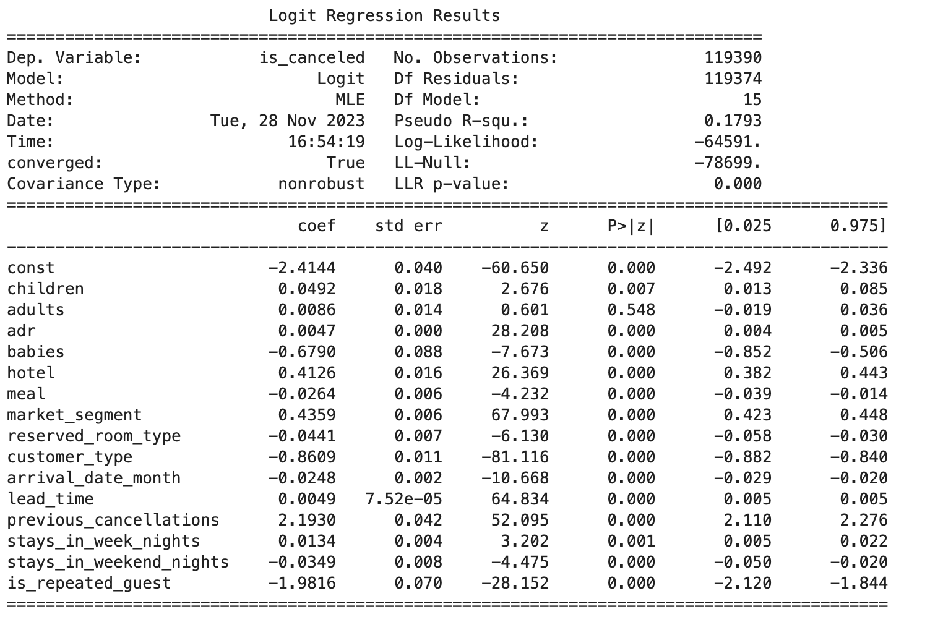
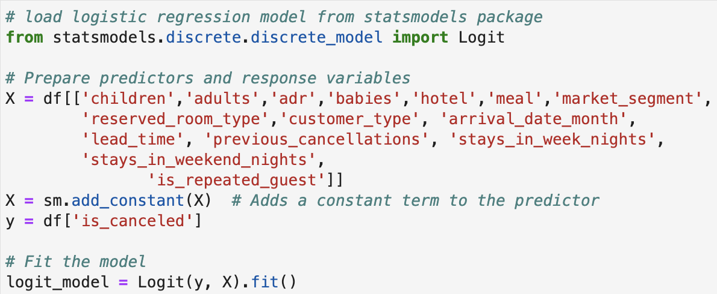
Logistic regression
a machine learning classification algorithm that is used to predict the probability of a categorical dependent variable.
Logistic Regression
All of the variables are statistically significant except adults.
They have the almost same order: previous_cancellations, is_repeated_guest, market_segment and customer_type have the most impact on is_cancelled with high coefficients (2.1930, -1.9816, -0.8609).
Intro
Data Preparation
Exploratory Data Analysis
Modeling
Conclusion

Slide 22
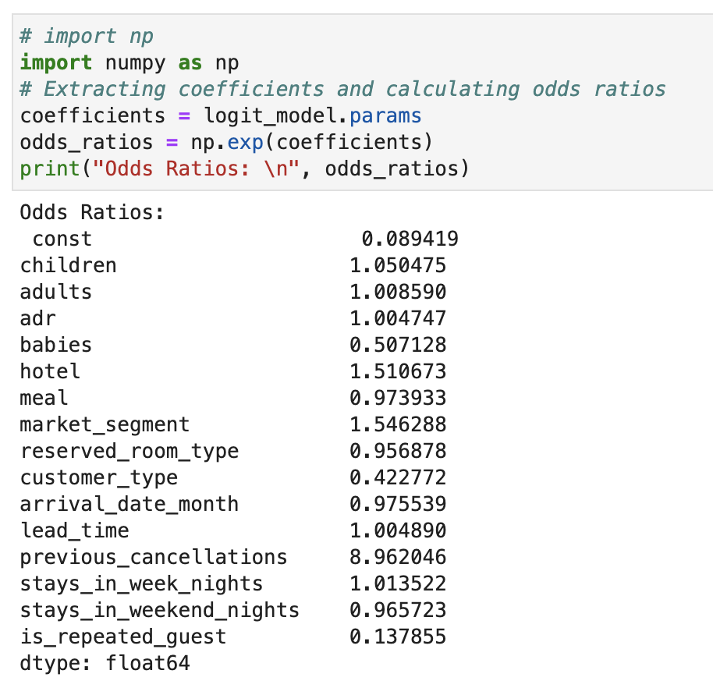
The odds ratio
Logistic Regression
Print odds ratio
R^2 = 17.93
variable previous_cancellations with very high odds ratio of 8.962.
Followed by market segment and hotel (1.54, 1,05)
Market segment has also a high odds ratio, which agrees with the correlation matrix.
Previous cancellation does not have such a big impact as with other analysis.
Intro
Data Preparation
Exploratory Data Analysis
Modeling
Conclusion

Slide 23
The end: Conclusions and answers to our prayers
Which variables affect cancellations the most?
From the correlation matrix `lead time`, `previous_cancellation` and `market segment` correlated the most with `is_cancelled`. However, in linear regression the ones witgh highest coefficients were `previous_cancellations`, `is_repeated_guest` and `babies`. Logistic regression had `previous_cancellations`, `is_repeated_guest` and `customer type` with highest coefficients. From the odds ratio it was `previous_cancellations`, `market_segment` and `hotel`. Therefore we can conclude that `previous_cancellations`, `is_repeated_guest`, and `market_segment` are the variables that most predict `is_cancelled`. Also all of the variables were statistically significant except adults.
Which hotel has a higher count of cancellations? And can we target these findings to compare them to the other hotel?
City Hotel has a higher Cancellation Ratio than Resort Hotel with 39.7%
Do certain countries have higher cancellation rates than others?
Portugal has the highest number of cancellations. We can see that Portugal has the highest number of cancellations (with a ratio of 1.3, meaning that they have more cancellations than bookings), folowed by Brazil and Italy. However, Portugal has probably the highest frequency of cancellations because they don't have to book flights in order to travel to the hotel, while other countries have to do that in advance.
Does market segment, customer type and meal affect cancellations?
Groups have a higher cancellation ratio that people that do not cancel. `Online TA` have the highest number of not-canceled and canceled. Transient has the highest cancellation rate.
Which seasons or months tend to have the highest number of cancellations?
June is the month where most people cancel, followed by May and August. July and August is where more people check out and where the hotel gets most of its revenue. In 2015 more people cancelled than in the other years
How does the pricing differ per type? And does this correlate to cancellations?
In July, August and September Resort Hotel has much higher prices and peak. Their prices were the highest, but still more people booked. However the cancellation ratio was still lower than in June.
What strong connection is there to returning customers?
Returning customer usually do not cancel, and people who already cancelled tend to cancel again.
Intro
Data Preparation
Exploratory Data Analysis
Modeling
Conclusion

